Slide 1
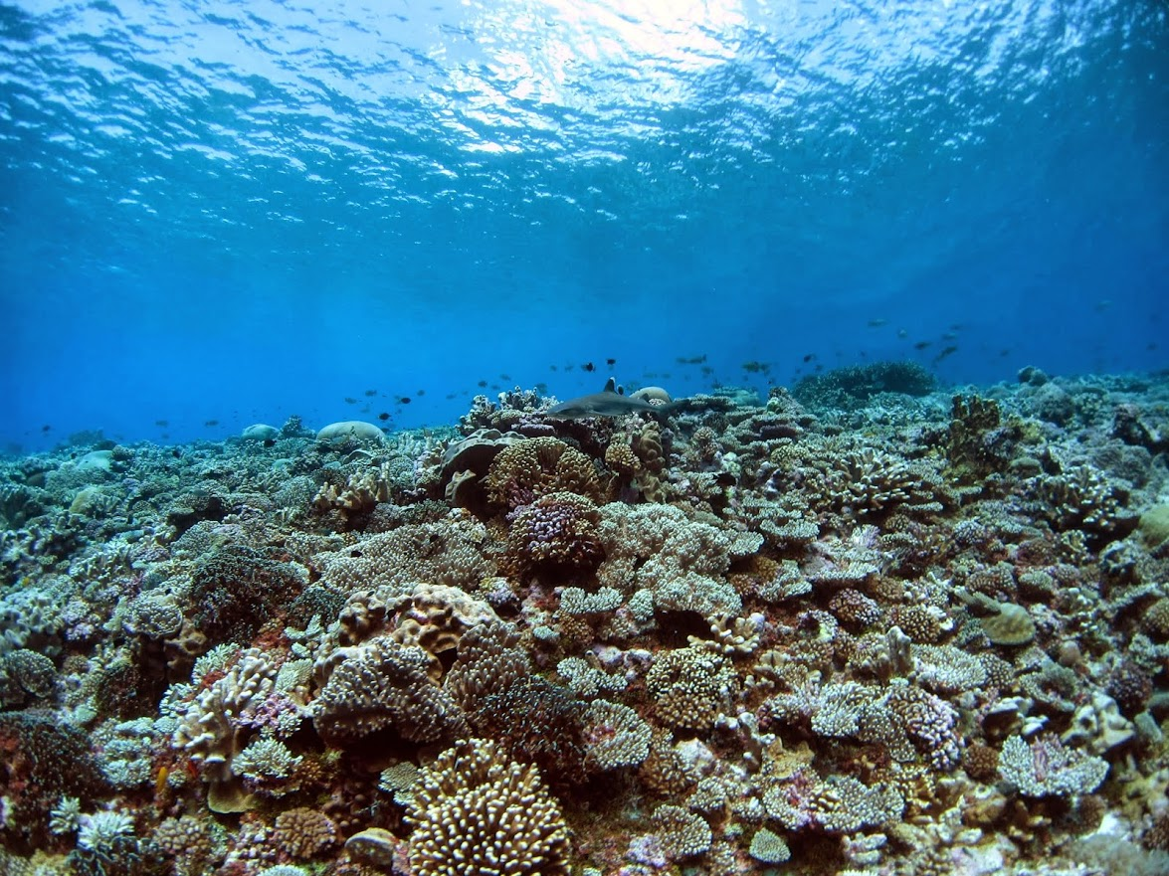






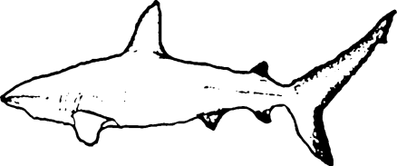






Coral Reefs and Coastal Fisheries across Micronesia
Peter Houk¹; Micronesia Coral Reef Monitoring Programs²; Javier Cuetos-Bueno¹; Rodney Camacho¹; Matthew McLean¹; Jessica Gradyan¹; Dalia Hernandez¹; Funding organizations⁴
1
4
4
4
2
2
4
4
2
2
2

Slide 2
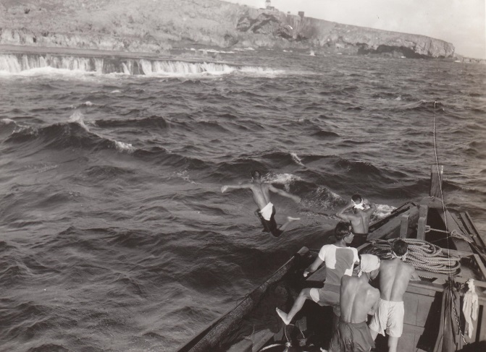
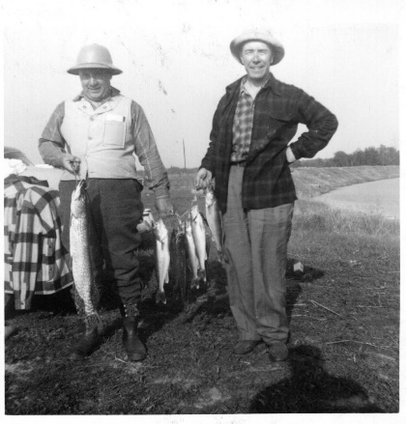
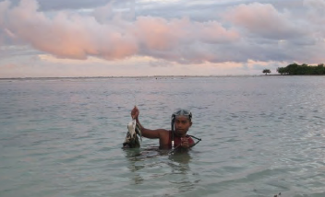
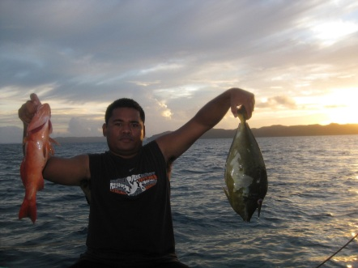
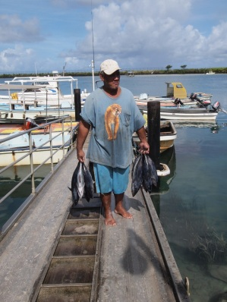
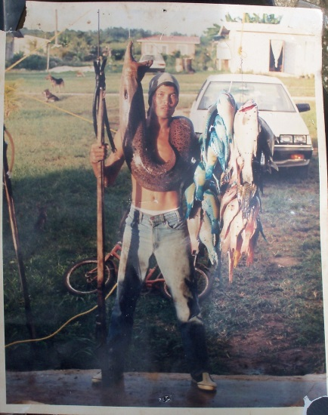
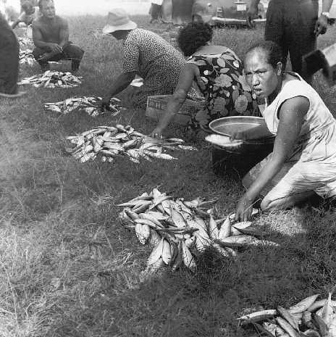
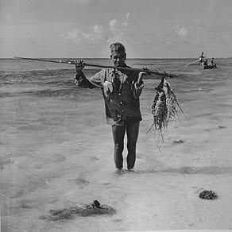
The culture of fisheries

Slide 3
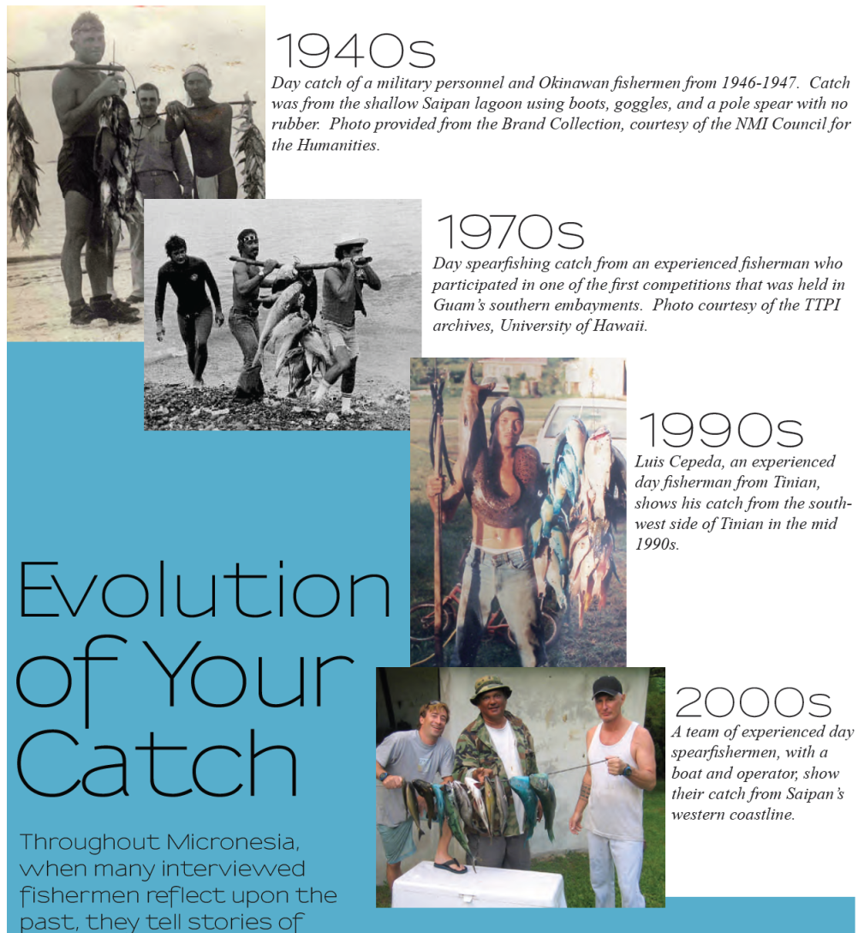
General trends
$ = cost of catching fish
$$$$$
$$
catch
$
1940’s
2000’s

Slide 4

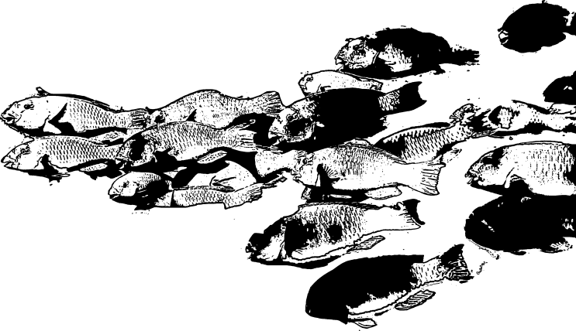

Birkeland’s Fisheries Ratchet
Fish move further away
Cost to catch goes up
Cost in market goes up, but not as much
Fishermen have to catch more
Fish get depleted
Ecosystem, economic, and social consequences
Bioscience 2004

Slide 5
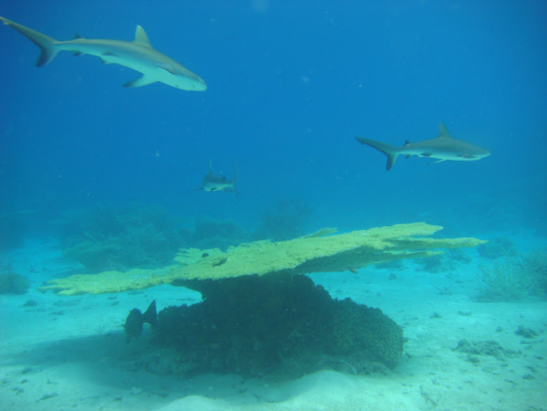
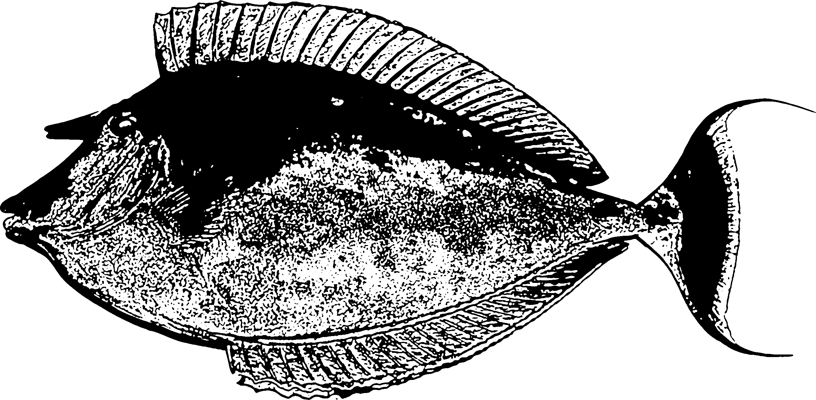
Micronesia reefs and fisheries
Functional role of fish
Fishing pressure as the primary driver of reef health
Status of our fishery
Unified management themes

Slide 6
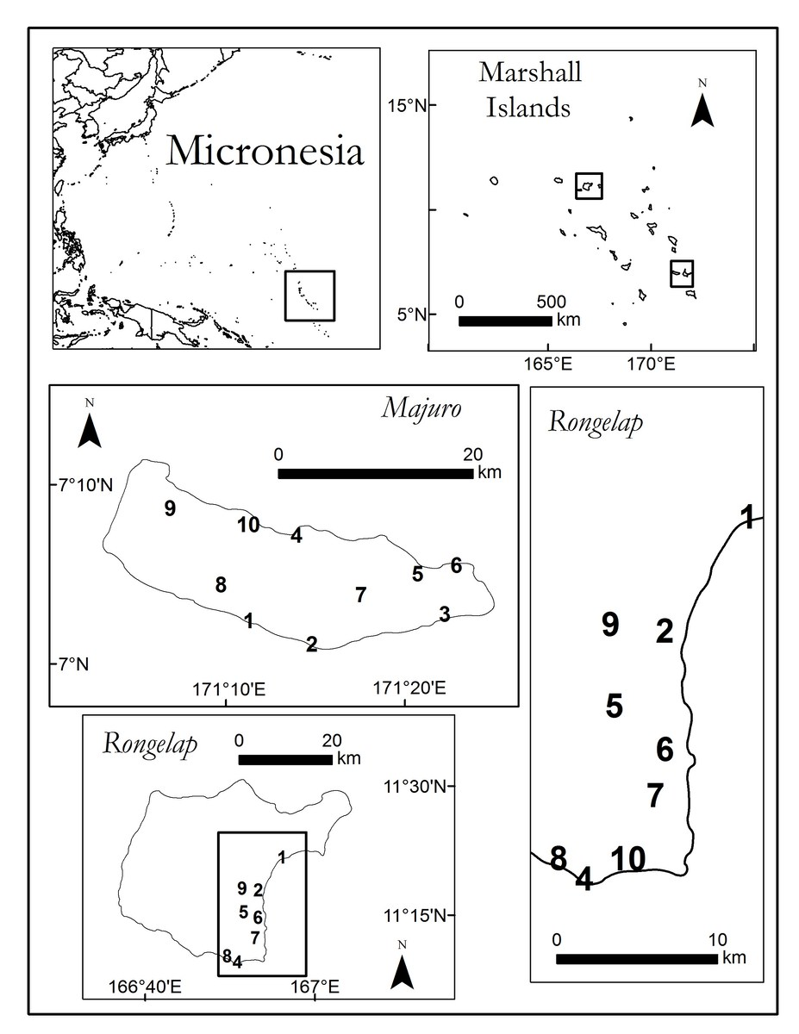
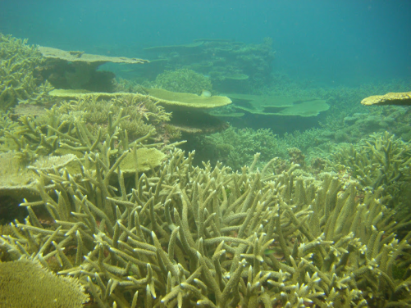
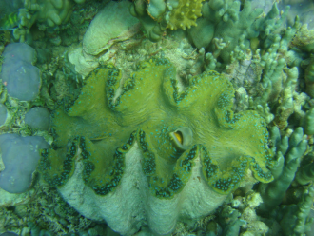
Reefs without humans

Slide 7
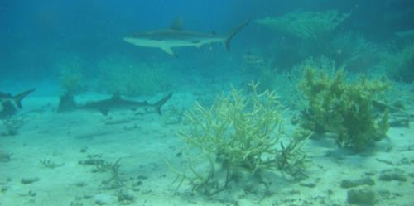
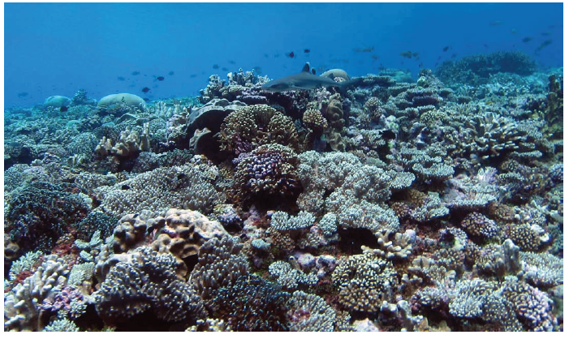
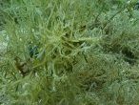
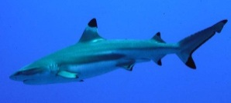

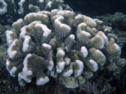


Rongelap – reef characteristics

Slide 8
Across Micronesia

Slide 9
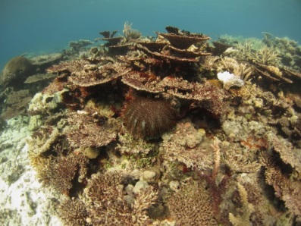
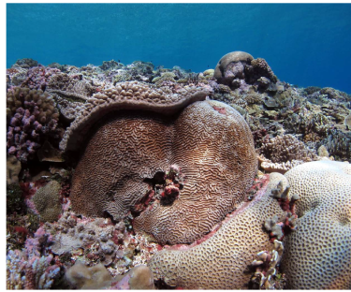
Benthic substrates

Slide 10
Patterns hint fisheries and reefs are related, but how?

Slide 11
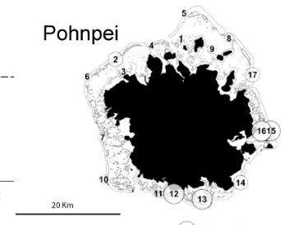
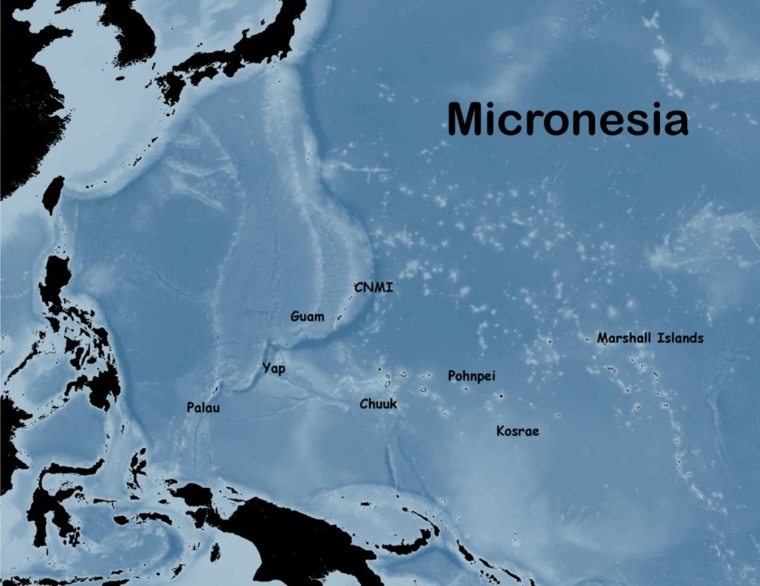


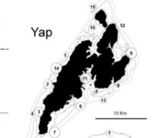


The Micronesia Challenge
Combined efforts and technical expertise across Micronesia
Standardized data
  Coral Reefs
  Fisheries

Slide 12
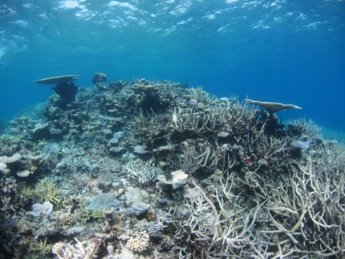
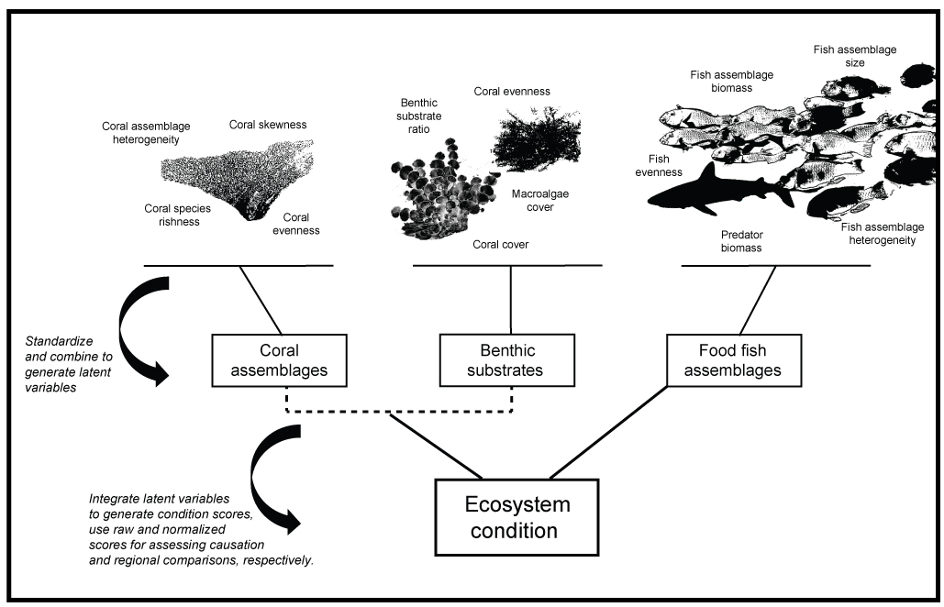
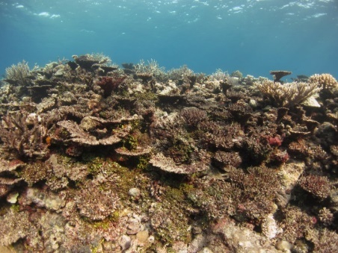
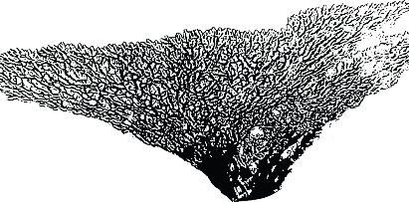


Reef “health”
Components of reef health similar to human health, blood pressure, cholesterol,

Slide 13
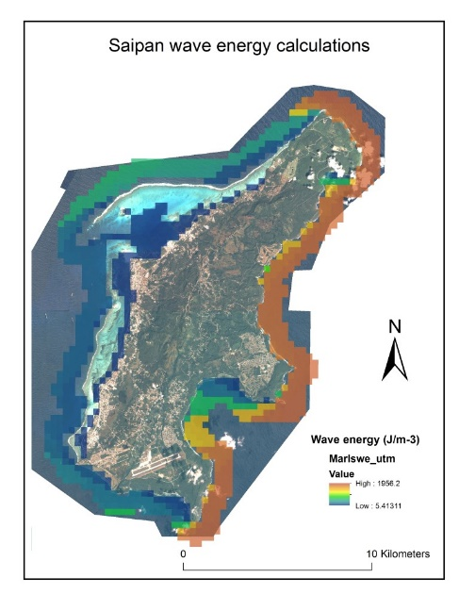
What drives healthy reefs?
Natural environments?
Fishing access?
Pollution proxy?

Slide 14
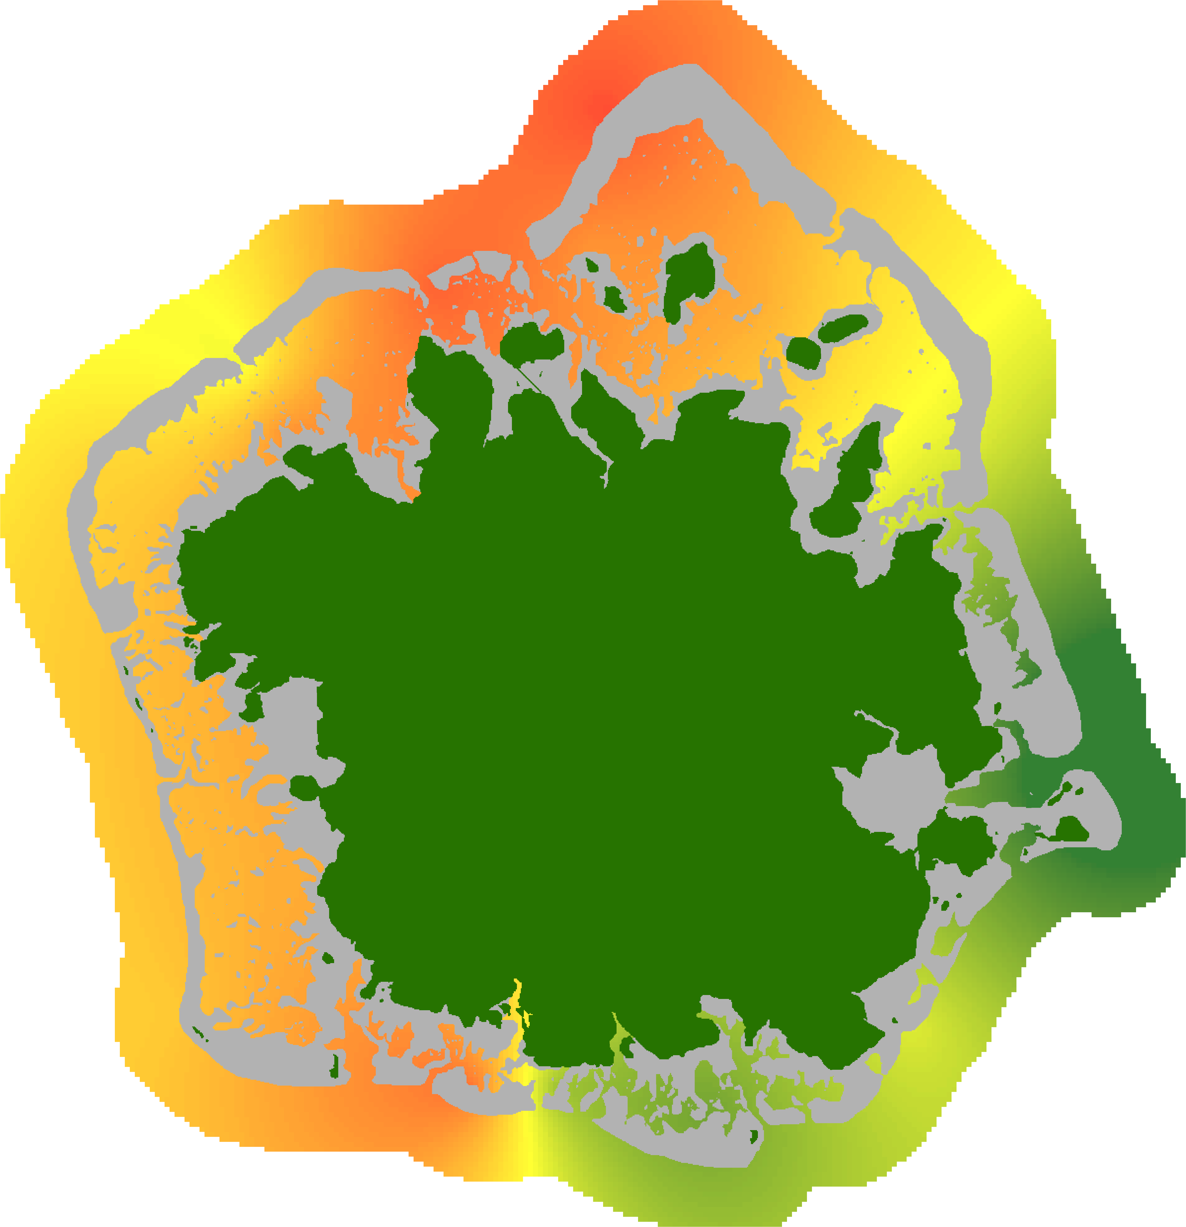

Pohnpei
Nan Wap
Red – less healthy
Green – more healthy
Madamken
Pehlang
Nan Mweli
Kolonia
High Fishing access
Low Fishing access
2012 - 2014 data

Slide 15
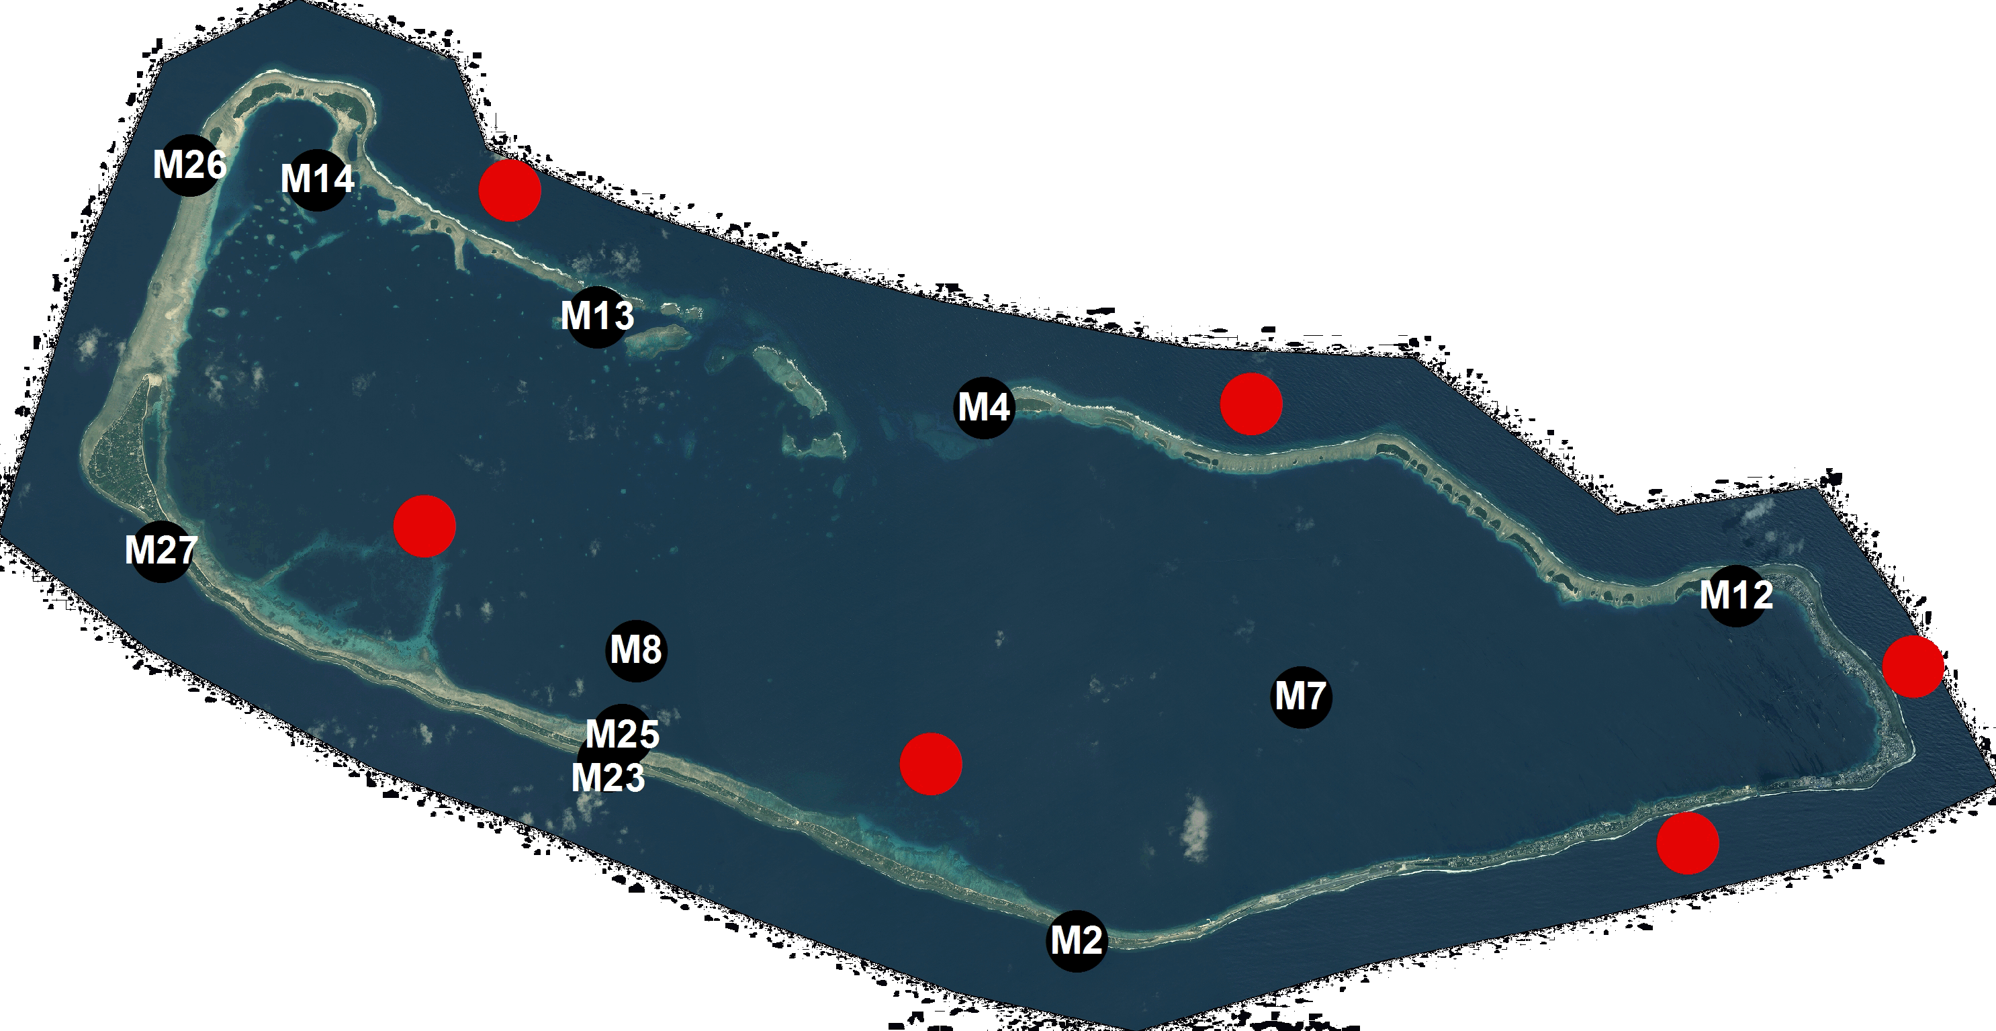
Majuro
Fishing access

Slide 16
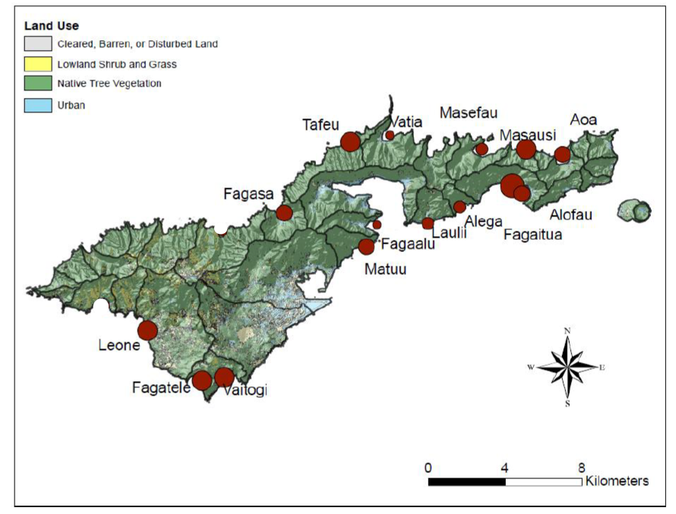
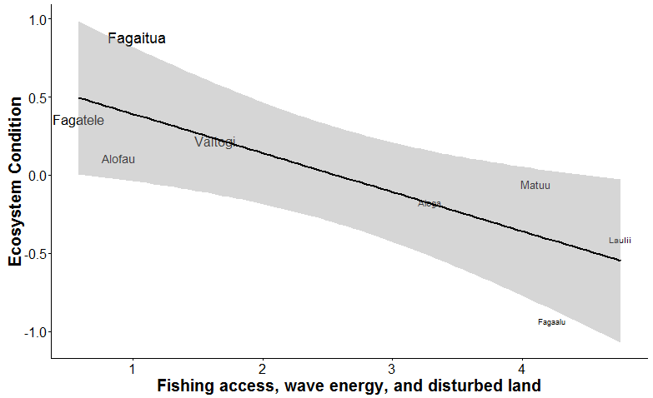
American Samoa
Circle size = reef health/condition

Slide 17
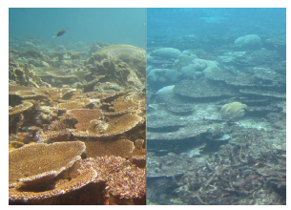
Interesting 1986 baseline in Kosrae
Then ---- Now

Slide 18

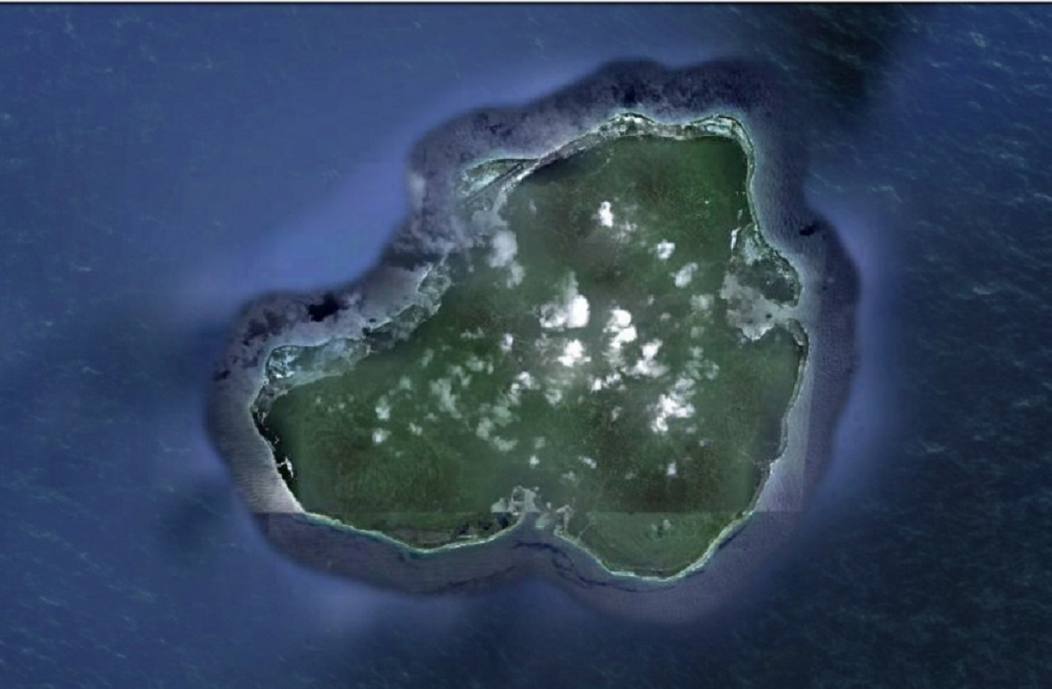
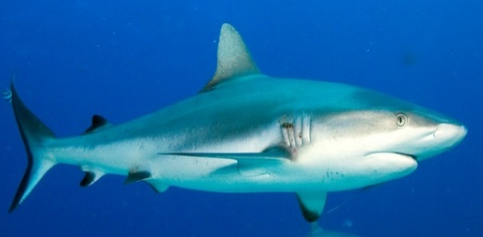

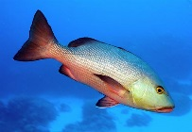
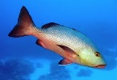
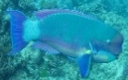

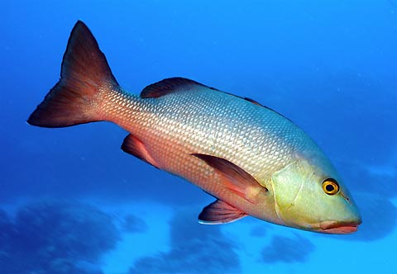
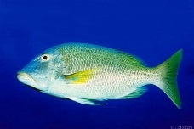

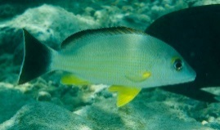



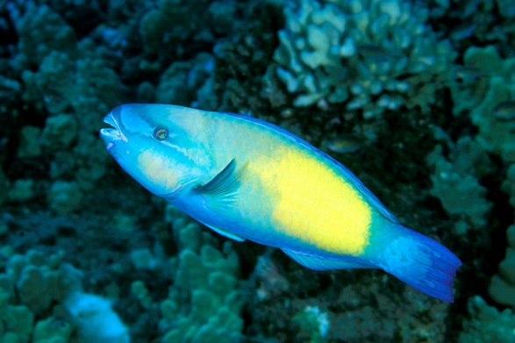
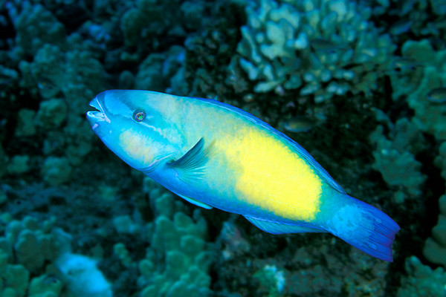



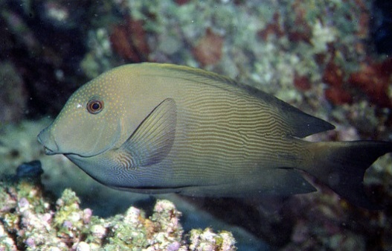


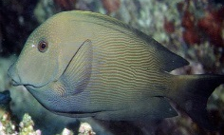
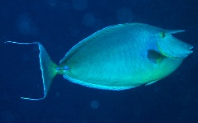
1986
Low Waves
1986
High Waves
2015
2015

Slide 19





Change from 1986 to 2016

Slide 20


Laolao Bay, CNMI
1992
2010/11

Slide 21







Reef slope – fish changes
SPC – Stationary point count

Slide 22
Summary

Slide 23



Declining fish populations are primary drivers of reef status across most Pacific islands

Slide 24
Sustainable societies, reefs, and economies depend on fisheries

Slide 26







Collaborative fisheries monitoring

Slide 27

Economics of fisheries
CNMI
Estimated $2.4 million USD per annum for these jurisdictions

Slide 28









$144 K
>200 species in fishery
$99 K
$74 K
$66 K
9 species make up greater than
50% of commercial landings
$57 K
$55 K
$51 K
$1.2 million USD in fish sales
across Chuuk, Pohnpei, Yap, CNMI, and Kosrae (per annum – based on our study years)
$41 K
$28 K

Slide 29
How did these species become dominant?

Slide 30












Evolution and management of fisheries
Size-based management most effective
Annual catch yield (kg)
Less management needed, only in heavily exploited fisheries
Seasonal or temporal ban/quota; temporary bans
Low fishing
High fishing
time

Slide 31





Example from data

Slide 32




Size matters

Slide 33




Predators matter
=

Slide 34
Knowledge, collaboration, APIL, and sustainable futures

Slide 35





Social, ecological, and economic problem that we can solve together
growing reality ------------- fisheries evolution ------------- back in the day!

Slide 36
Outreach on the way…

Slide 37









Kammagar, Sulang, Kulo, Kalahngan, Kommol tata, Kinisou, Si yu’us ma’ase, and Olomwaay
peterhouk@gmail.com

Slide 38


The fishing footprint

Slide 39

Fishing access primary driver
Notes:
Describe fishing pressure metric, was used in Taylor et al. Guam – similar to actual fishing intensity

